Slide 1
QA World Cup – Round 4
Team Bharat – Bharat Garg, Tarun Namdev, Nikita Nuwal, Piyush Tiwari

Slide 2
Automation Problem
https://www.yammer.com/nagarro.com

Slide 3
Automation Problem
Framework Features
What is problem : Problem type: Test Automation 1
Why BDD:
BDT increases and improves collaboration. ​
Enables everyone in the project to easily engage with the product development cycle. ​
And by using plain Gherkin language, all can write behavior scenarios.​
It closes the gap between business and technical people.​
And provides -​
High Visibility​
End User Satisfaction

Slide 4
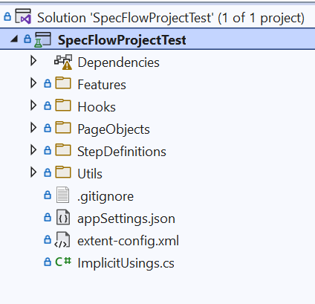
Framework Structire

Slide 5
Performance Testing Problem
Create script to test the performance of copy command. Use any arbitrary file and location for copy.

Slide 6
Performance Testing Problem
Framework Features
What is problem
Why Jmeter:
GUI Design and Interface
Result Analysis and Caches
Highly Extensible Core
100% Java scripted
Pluggable Samplers
Multithreading Framework

Slide 7
Test Approach
Problem type: Designing Test Approach

Slide 8
Thank you
Team Bharat – Bharat Garg, Tarun Namdev, Nikita Nuwal, Piyush Tiwari

